Slide 1
ACADGILD Project
Linear Regression Model Building
-Rahul Deshpande

Slide 2
Project statement-
Create a Linear Regression Model for DVD sales data set –
Advertising: The budget spent on advertising.
Sales: Number of copies sold
Plays: Number of plays on Radio Mirchi
Attractiveness: Attractiveness of the brand (rating scale from 1 to 10; 1 being the worst and 10 being the best)

Slide 3
Data Reading and Cleaning-
Read the data –
We imported the file into R using following command-
read.csv("Sales_dataset.csv",header = T)
Then we stored the data into a datafram calles SalesData.
We attached the dataframe using attach() command so that we can access the data easily and quickly.
We ad a look at the data using head() command; we found that-
There are 4 variables namely, advertise, sales, plays and attractiveness.
We used str() command to get metadata of this file –
There are 200 records with 4 variables.
Attractiveness is a continuous numeric variable, while sales, plays and advertise budget are discrete integers.
Attractiveness seems like a factor as it has reparative digits ranging from 1 to 10.
Now we used summary() command to get descriptive analytics insights.
Overall data looks clean without any invalid values.

Slide 4
Descriptive analysis-
We used summary() command to get insights-
Advertisement-
The minimum advertisement budget is 9 while 2272 is the most.
The average budget is 608 per advertise. A density plot shows that 2272 is an outlier which is the highest budget.
It is not a normal distribution; it shows a positive skewness with tail at right side.
It shows a positive Kurtosis, the probability of extreme values is lower than the normal distribution.
Sales-
Sales are ranging from 10 to 360 with average sales of 193.2.
A density plot shows that Sales have bi-nodal approximately normal distribution.
We can say that sales are approximately negatively skewed.
It shows a negative kurtosis, the probability of normal distribution is higher than the extreme values.

Slide 5
Descriptive analysis (Cont..)-
Plays-
There are some advertisements with 0 plays with maximum plays as 63.
Mean is approximately equal to median, hence it is a normal distribution.
A density plot shows that Plays have imperfect normal distribution with flattened peak and thicker tails.
Plays show negative Kurtosis.
Attractiveness-
Attractiveness is a factor with values ranging from 0 to 10.
On an average, every play is rated with 6.77 rating. Best rated Play has 10 rating.
Density plot shows that Attractiveness is negatively skewed.
It has a positive Kurtosis that means the probability for normal distribution is higher than that for extreme values.

Slide 6
Descriptive analysis (Cont..)-
Correlations between variables-
We have excluded Attractiveness for this calculations.
Advertise budges and sales are positively correlated, that means if we increase advertise budget, sales will go up.
Advertisement budget and Plays are weakly positively correlated. Advertisement budget has very less impact on number of plays.
Plays and Sales have a strong correlation. If we increase the plays, there is a high chance that the sales will also go up.

Slide 7
Linear regression modelling-
We need to find relationships between the variables from this dataset. We will use linear regression to find the relationships.
Assumptions-
We assume that Sales data would be the dependent variable i.e. Target variable and others would be predictor variables.
All predictor variables are non-random.
Attractiveness is a factor variable that needs to be converted from integer to a factor.

Slide 8
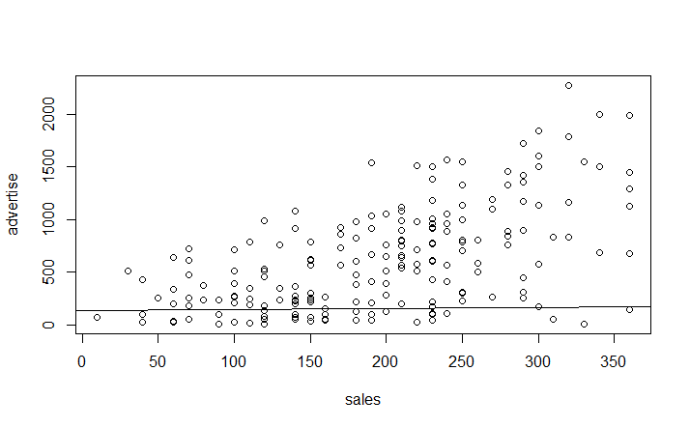
Linear regression modelling-
Simple Linear Univariate Regression Model-
Sales and Advertise-
If we use plot function , we get an insight that sales and advertise are positively correlated.
We created a model for Sales as a dependent variable and advertise as predictive variables.
We used the function lm(Sales~Advertise) to get the model into fit_sa dataframe.
We used the summary(fit_sa) function to get the insights-
Residual standard error is 47.1 which is not a good indication. Hence, the discrepancy between actual and predicted value would be more.
The multiple R-squared values is 0.33, i.e. only 33% of the variance in the dependent variable can be explained by the model which is not good. Hence we can conclude that this is not the best model.
Advertise has a significant impact on sales.
P value is very less, hence null hypothesis is rejected and we can conclude that the Sales and Advertise are related to each other.
If we plot a line on the scattered chart , we can clearly see that the model is not good.

Slide 9
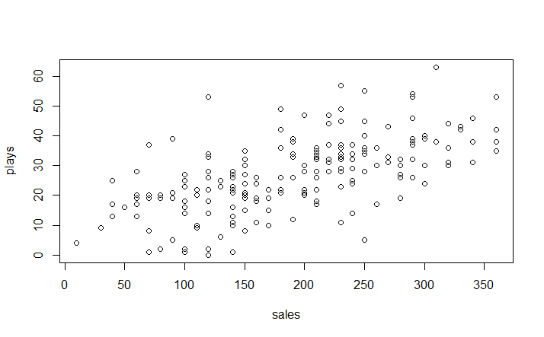
Linear regression modelling-
Simple Linear Univariate Regression Model-
Sales and Plays-
If we use plot function , we get an insight that sales and advertise are positively correlated.
We created a model for Sales as a dependent variable and advertise as predictive variables.
We used the function lm(Sales~Plays) to get the model into fit_sp dataframe.
We used the summary(fit_sp) function to get the insights-
Residual standard error is 64.7 which is not a good indication. Hence, the discrepancy between actual and predicted value would be more.
The multiple R-squared values is 0.35, i.e. only 35% of the variance in the dependent variable can be explained by the model which is not good. Hence we can conclude that this is not the best model.
Advertise has a significant impact on sales.
P value is very less, hence null hypothesis is rejected and we can conclude that the Sales and Advertise are related to each other.
If we plot a line on the scattered chart , we don’t even see the line on the plot. Hence the model is not good.

Slide 10
Linear regression modelling-
Simple Linear Univariate Regression Model-
Sales and Attractiveness-
We need to convert Attractiveness into a factor.
If we use plot function , we get an insight that sales and advertise are positively correlated.
We created a model for Sales as a dependent variable and advertise as predictive variables.
We used the function lm(Sales~as.factor(attractiveness)) to get the model into fit_sp dataframe.
We used the summary(fit_sat) function to get the insights-
Residual standard error is 75.3 which is not a good indication. Hence, the discrepancy between actual and predicted value would be more.
The multiple R-squared values is 0.16, i.e. only 16% of the variance in the dependent variable can be explained by the model which is not good. Hence we can conclude that this is not the best model.
Advertise has a significant impact on sales.
P value is very less, hence null hypothesis is rejected and we can conclude that the Sales and Advertise are related to each other.

Slide 11
Linear regression modelling-
Multiple Linear Univariate Regression Model-
Sales as a target variable and rest all as predictor variables-
If we use the attractiveness as an integer, we get following results-
Residual standard error is 47.1 which is fairly least in all models.
We can get the linear regression equation as-
Y=-28.14+0.84*Advertise+3.38*Plays+11.33Attractiveness
Multiple R squared value is 0.66 i.e. 66% of variance in the Sales can be explained by the model which is a good sign.
Advertise, plays and attractiveness is significant but attractiveness is a factor with invalid intercept value.
P value is very less than 0.05 , hence we reject the null hypothesis and conclude that the Sales and all other variables are have a positive relationship between them.
But we can’t say that this is correct model as Advertise is a factor variable and we need to convert it to factor for correct calculations.

Slide 12
Linear regression modelling-
Multiple Linear Univariate Regression Model-
Sales as a target variable and rest all as predictor variables-
If we use the attractiveness as a factor variable , we get following results-
We get 11 variables out of which 9 are for attractiveness. As we have 9 variables created for attractiveness factor . We need to create dummy variables for attractiveness factor.
Residual standard error is 46.3 which is best of all models.
Multiple R squared value is 0.68 i.e. 68% of variance in the Sales can be explained by the model which is a good sign.
P value is very less than 0.05 , hence we reject the null hypothesis and conclude that the Sales and all other variables are have a positive relationship between them.
Creating dummy variables for attractiveness-
Make sure that attractiveness is a factor variable, if not then convert it into factor.
Now, create another dataframe for dummy variables of Attractiveness and save it as Sales_dummy.
We will use ‘dummy’ function from dummy library.
Sales_dummy<-dummy(SalesData)
Now we will exclude attractiveness variable from SalesData and attach the Sales_dummy dataframe to SalesData wihout Attractiveness and store the result in another dataframe calles New_SalesData.
Now build a linear model on New_SalesData.

Slide 13
Linear regression modelling-
Multiple Linear Univariate Regression Model-
Sales as a target variable and rest all as predictor variables-
Attractiveness is replaced by the dummy variables-
Residual follows the perfectly normal distribution with median value = 0.
Residual standard error is 46.3 that is the best of all models.
Coefficient of determination is 0.68 i.e. 68% of variance in target variable can be explained by the model.
All intercept values are valid and all variables are significant.
The p-value is very less than 0.05, hence we reject our null hypothesis and conclude that Sales and all other variables have a positive relation between them.
As the attractiveness increases, the significance also increases.
This is the best fit model for given dataset.

